Slide 1
SCC204 Requirement Engineering (1)-Principle
Zhang Jinyu – zjy@bjtu.edu.cn
School of Computer and Information Technology
SD408

Slide 2
Objectives for the next 2 weeks
Understand what requirements are
Learn how to write good requirements documents
Learn how to transition from requirements to design

Slide 3
Requirements
What is a requirement?
a description of what the system under development (SUD) should do and any constraints under which it must do it
It serves as a contract between the development team and the customer
It focuses on what the system will do, not how it will do it
e.g.:
The train shall be able to transport 5,000 passengers per hour from Lancaster to Manchester, versus
The train shall consist of 3 carriages pulled by an electric locomotive
Should be written at a level that the customer understands
功能

Slide 4
Separate Design & Requirements
1. The train shall be able to transport passengers from Lancaster to Manchester
2. The capacity shall be at least 5000 passengers per hour
3. The development costs shall be less than £5million
4. The operating costs shall be less than £150,000 per day
5. Late arrivals shall occur less than 1% of the time
6. The impact on the environment should be B+ rated or higher
Design considerations: type of locomotive (electric, diesel, etc.); type of track; number & type of carriages; design of carriages (e.g., type of seats); etc.

Slide 5
Good or bad?
“the telephone system shall be able to inform callers of the anticipated wait time based on the number of calls, average duration of calls, and number of calls ahead of them” Good
“system shall support client inquiries from four access points: in person, paper-based mail, voice communication, and electronic communication (DSL, dial-up, fibre optic)” Good
“the telephone system shall be able to support an 0800 number system” Bad
“if an individual double-clicks on an event in a member’s journal, the system shall display the electronic information and the images associated with an event” Bad
“the telephone system shall be able to handle 97000 calls per year and must allow for a growth rate of 15 percent annually”Good

Slide 6
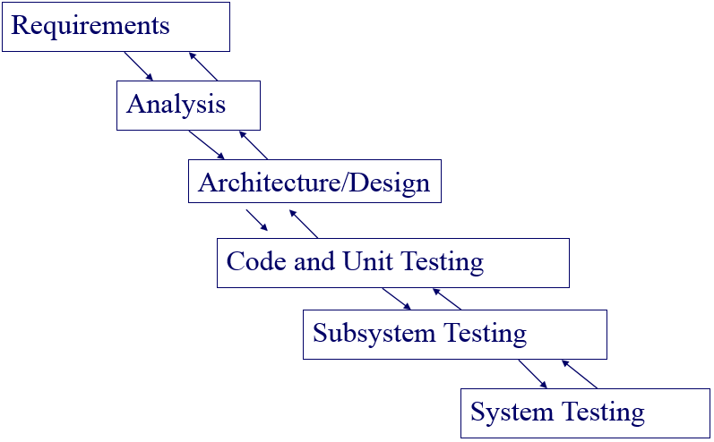
Software lifecycle

Slide 7
Writing Requirements
Usually a text document
● cf. IEEE Standard 830
Includes:
● a general description of the context and domain
● the scope of the product
● a set of SHALL statements prescribing what the system will do
both functional and non-functional
Considerations:
● use simple precise text
● don’t make assumptions about the reader’s knowledge
● involve as many stakeholders as possible
● be aware that English is an ambiguous language

Slide 8
Non-functional requirements
Constraints on how the SUD should behave
Typical examples:
● availability
● performance
● security
● usability and accessibility
● reliability
NFRs are SHALL statements that precisely specify these constraints
任何时间都可用
性能范围，如时延、丢包率
承受外界攻击能力
访问途径、渠道
抗内部打击能力

Slide 9
FR or NFR?
1. The train shall be able to transport passengers from Lancaster to Manchester FR
2. The capacity shall be at least 5000 passengers per hour FR
3. The development costs shall be less than £5million NFR
4. The operating costs shall be less than £150,000 per day NFR
5. Late arrivals shall occur less than 1% of the time NFR
6. The impact on the environment should be B+ rated or higher NFR

Slide 10
Requirements engineering
A systematic process of …
•Understanding the problem
•Specifying the solution
… and once the solution has been validated ...
•Managing the requirements

Slide 11
Understanding the problem
Understand the as-is situation
What is the business goal?
Who are the users and other stakeholders?
What do they do?
How are they organized?
What is the operational environment?
“Green field” or evolution of existing system?
Custom system or marketed product?
What can we change, what must we keep?

Slide 12
Specifying the solution
Specify the system-to-be
What is needed to:
Achieve the business goal?
Support the users?
How do these requirements interact?
Some may conflict
Some will be higher priority than others
Some will cost more than others
Are the requirements we’ve formulated right?

Slide 13
Managing the requirements
Once the customer has ‘signed off’ the requirements, our job is done, right?
No!

Slide 14
Why requirements are managed
Requirements beget requirements …
Business goals -> user requirements -> software requirements -> software components
We want to track them
To make sure they’re all implemented
To be able to tell when we can test them
We might have to reappraise the requirements
e.g. if we run out of money or time
Requirements change
Because we make mistakes
Because the world changes

Slide 15
Problems of requirements analysis
Stakeholders don’t know what they really want.
Stakeholders express requirements in their own terms.
Different stakeholders may have conflicting requirements.
Organizational and political factors may influence the system requirements.
The requirements change during the analysis process. New stakeholders may emerge and the business environment may change.

Slide 16
Next
Requirements elicitation
● where do requirements come from?
Should involve as many stakeholders as possible 
Requirements workshop
● bring together relevant stakeholders
● brainstorm system concepts and contexts
● discuss conflicting requirements from each stakeholder and try to come to a consensus without criticizing each other

Slide 17
Question?

